Slide 1
Comparing Linear TD to SGTD on Hus Game

Slide 2
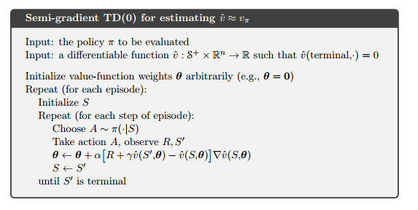
Semi-gradient TD(0)

Slide 3



Linear TD
Update Rule Differs:
The difference between LTD and SGTD is the addition of an adjustment term during the weight updates.

Slide 4
Methodology
1000 states random walk:
Used one hot encoding and grouped the states into 10 different groups
Used a linear value function V(s,w) = w^T*f(s) where f(s) is a vector of 10 entries, 1 for each group
As a consequence of using this parameterization, the weight associated with each feature represents the expected return for this group of states.
Ran both algorithms over 1000 episodes using various learning rates.

Slide 5
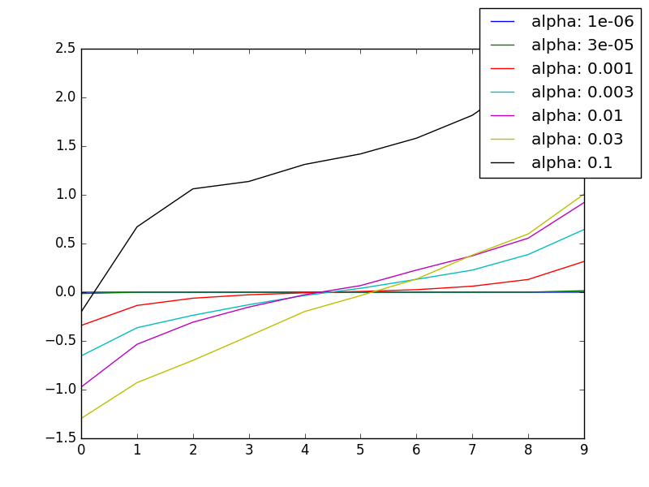
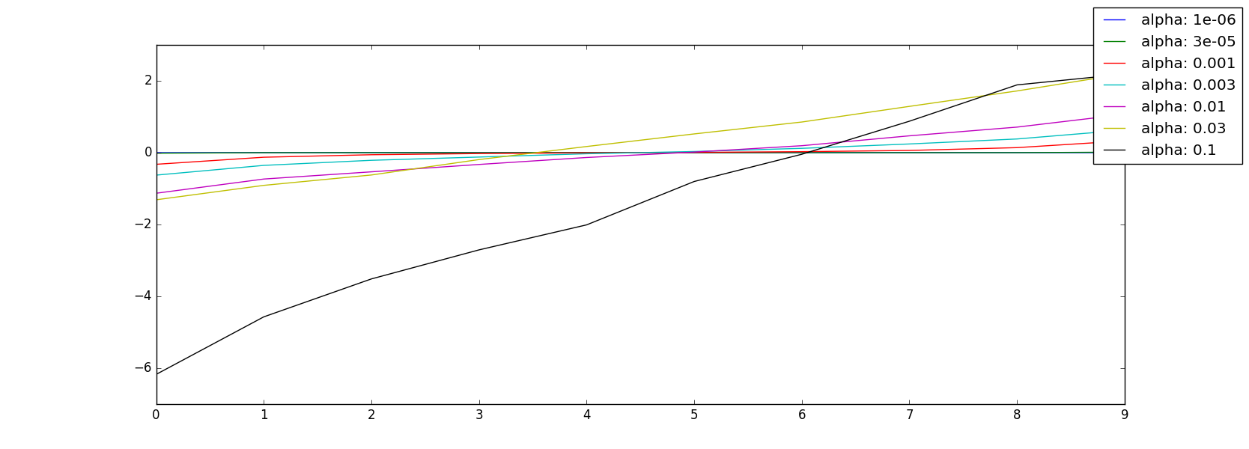
1000 states random walk results
SGTD results
Both methods perform well on the 1000 states random walk problem when a good learning rate is chosen.
LTD results

Slide 6
Hus
Rules : http://mancala.wikia.com/wiki/Hus
Each state is represented by a feature vector of 17 entries. One entry represents the sum of the seeds on the player’s side of the board. The other 16 are binary variables representing whether or not the opponent can capture the seeds found in pits 1-16.
The differentiable function is a linear combination of those features
Ran both algorithms over 1000 episodes to learn valid weights and then again over 1000 episodes to estimate the RNEU. Did this 5 times for each learning rate value and averaged the results.
I used a policy that picks a valid move randomly.

Slide 7
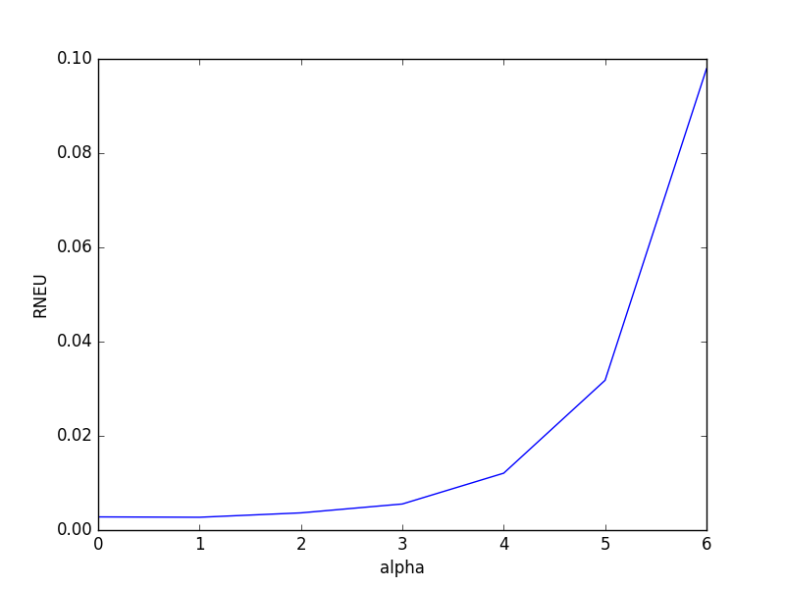
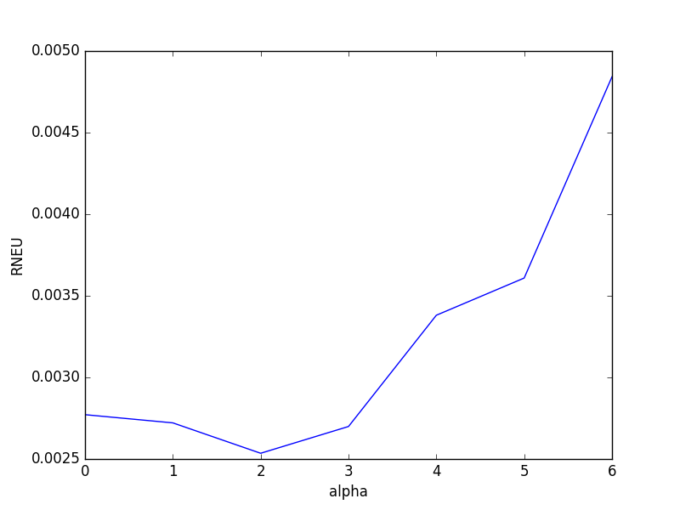
Hus Results
SGTD results
I used a reward of 1 when a player won the game, 0 otherwise
LTD results
The estimate for the residual error is much lower when we use LTD than when we use SGTD, not matter the value of the learning rate. This seems to suggest that in the case of HUS, LTD is more effective at estimating the true value of every state than SGTD is.

